Slide 1
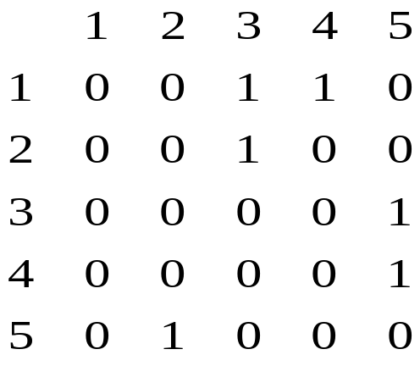
Graph Representation
G=(V, E) -graph:
  V = V(G) - vertices;
  E = E(G) - edges (connecting pairs of vertices)
1
2
3
4
5
Adjacency-list
Adjacency-matrix
1
3
4
2
3
3
5
4
5
5
2

Slide 2
Depth-First Search
Methodically explore all vertices and edges
All vertices are White, t = 0
For each vertex u do if u is White then Visit(u)
Procedure Visit(u)
  color u Gray; d[u] ← t ← t +1
  for each v adjacent to u do
  if v is White then Visit(v)
  color u Black
  f [u] ← t ← t +1
Gray vertices =
stack of recursive calls

Slide 3
Depth-First Search
Runtime of DFS = O(V+E)
  once per vertex
  once per edge
Kinds of edges:
  tree edge (gray to gray)
  back edge (gray to gray)
  forward edge (gray to black)
  cross edge (gray to black)
G is undirected ⇒ only tree and back
Undirected G is acyclic ⇔ no back edges
  If a graph is acyclic can be found in O(V) time

Slide 4
Topological Sort
DAG = directed acyclic graph
  has levels or depth
  cannot return up
Topological Sort(G)
  call DFS(G) to compute f[v]
  sort according to finishing times
Directed graph G is acyclic ⇔ no back edges

Slide 5
Breadth-First Search
BFS discovers all vertices at distance k before any vertices at distance k+1.
Initialization
  assigns ∞ to all vertices: w(v)= ∞
  color all white
Color s gray, w(s)=0, enqueue s in Q
for the head u of Q
  for each v adjacent to u,
    d[v]=d[u]+1
    enqueue v in Q
  dequeue Q
  color u black

Slide 6
Breadth-First Search
Run-time = O(V+E)
Shortest-path tree
  the final weight is the minimum distance
  keep predecessors and get the shortest path
  all BFS shortest paths make a tree

